Slide 1
Lecture 5
Spring's Dependency Injection(DI) with Collection property
like Set, List and Map

Slide 2
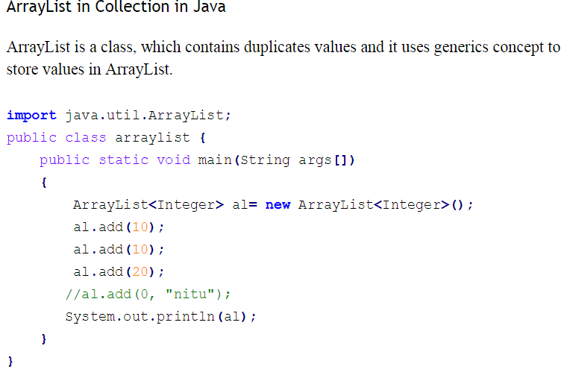
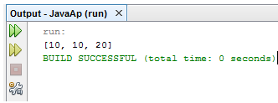

Slide 3
How to provide value of a java Collection from spring's configuration file ?
Ans
We will do the same task using Spring framework in different way.

Slide 4
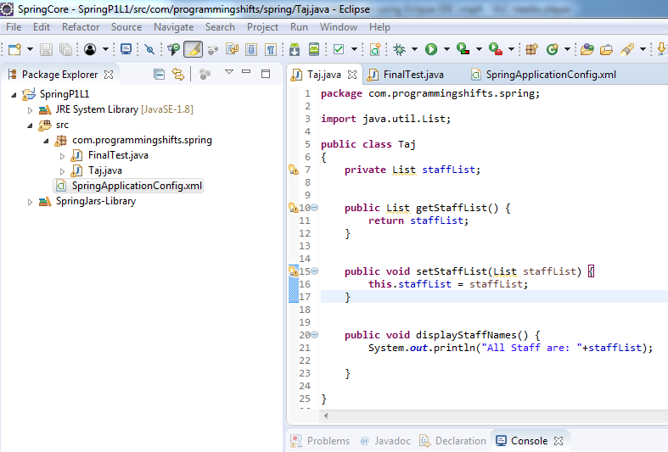

Slide 5
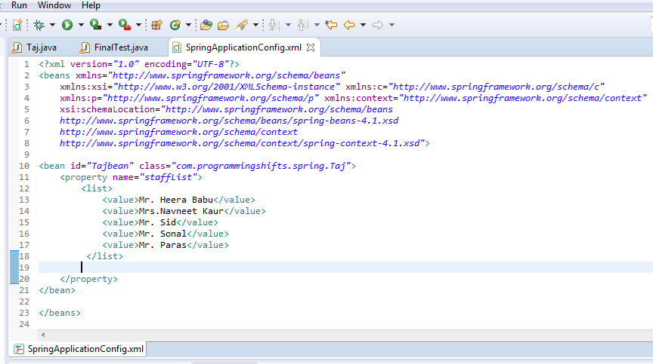

Slide 6
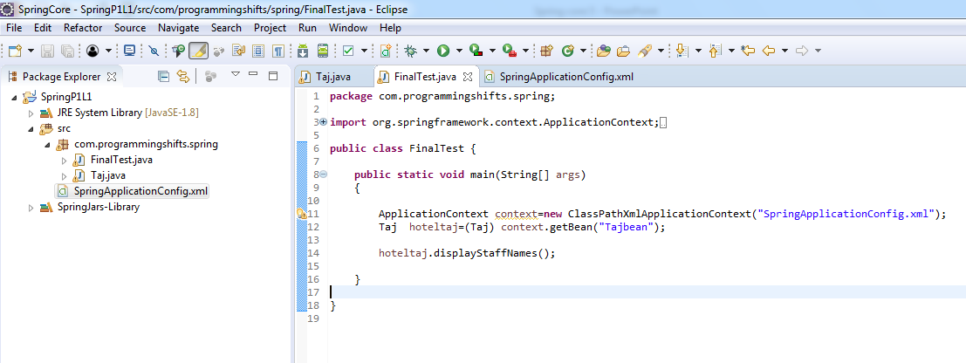

Slide 7
